Slide 1
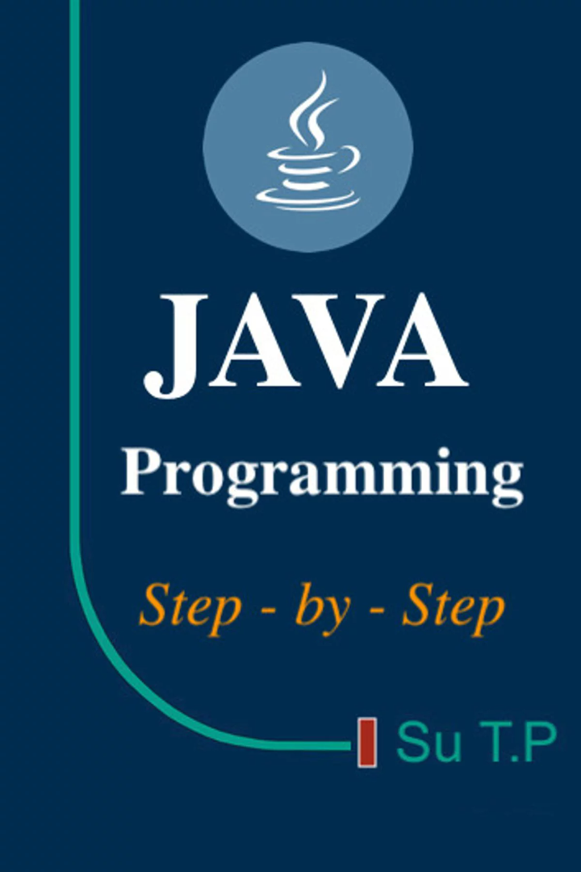

Understanding OOPs in Java
Learn the core concepts of Object-Oriented Programming in Java, including encapsulation, inheritance, polymorphism, and abstraction.
by AKULA KUSUMANJALI

Slide 2

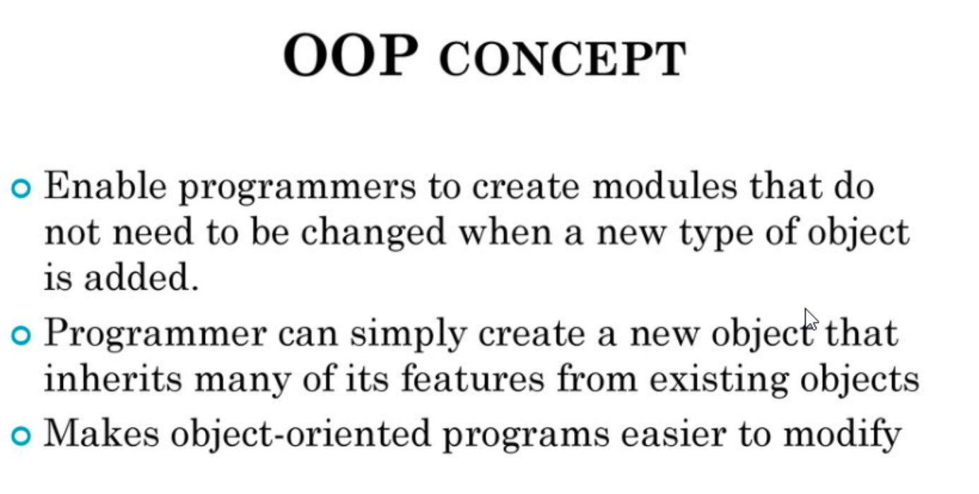
Introduction

Slide 3

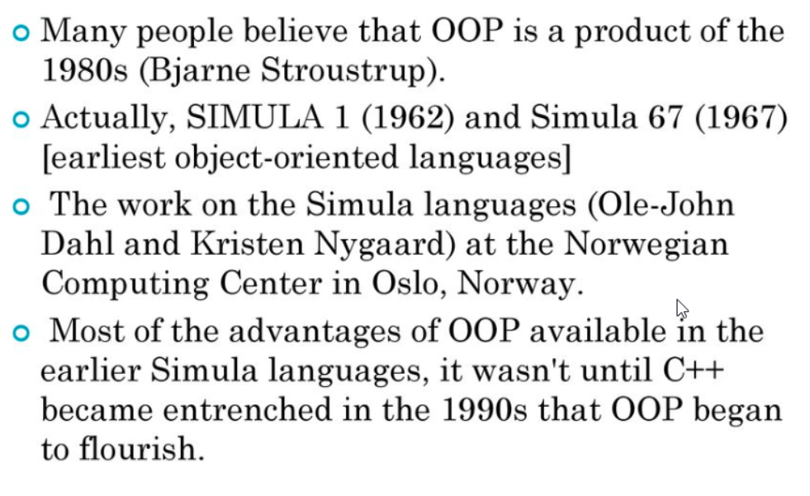
HISTORY OF OOPS

Slide 4

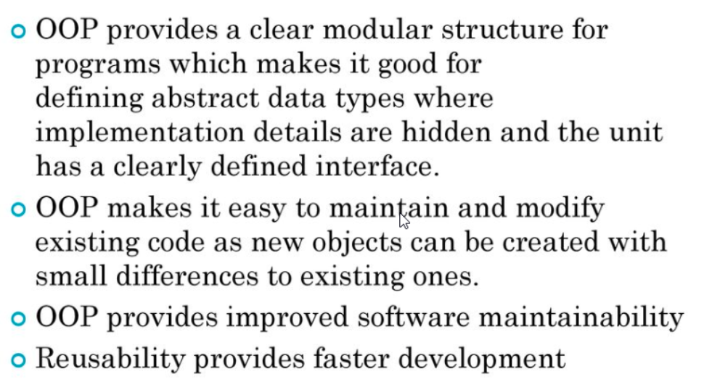
Advantage of using OOPS

Slide 5

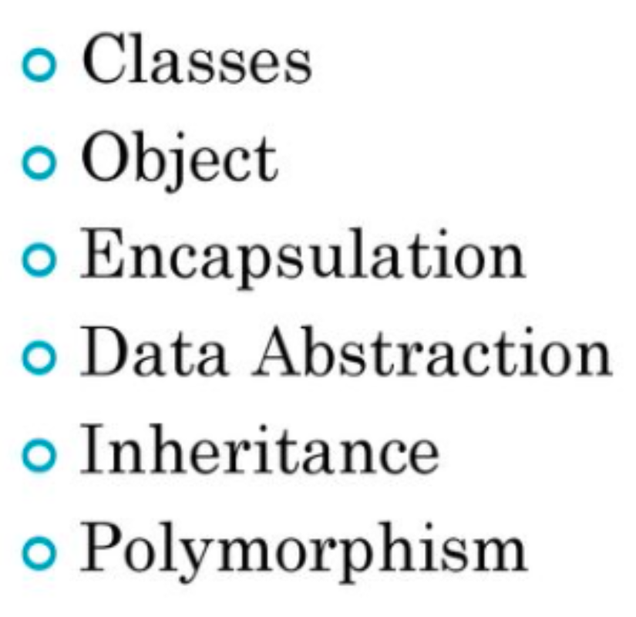
Terminology of OOPS

Slide 6

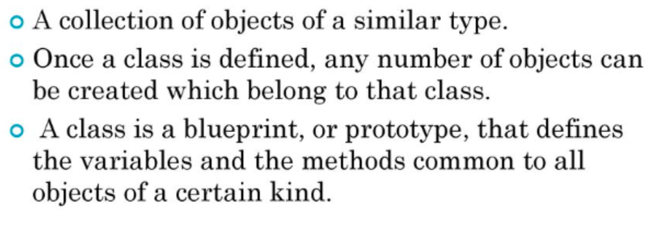
Classes

Slide 7

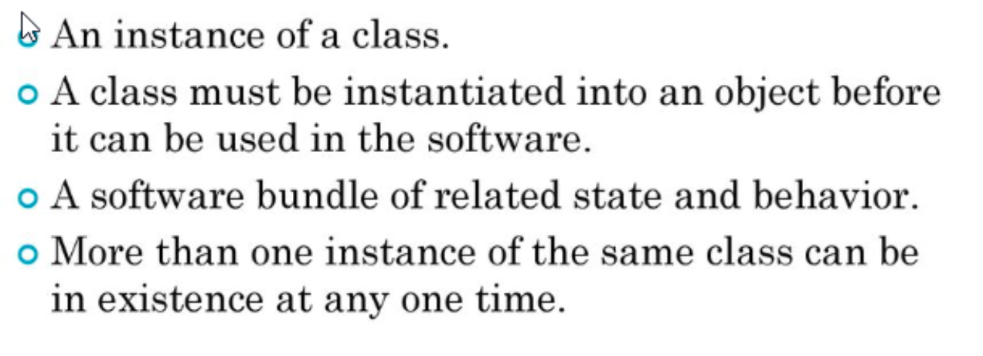
Object

Slide 8
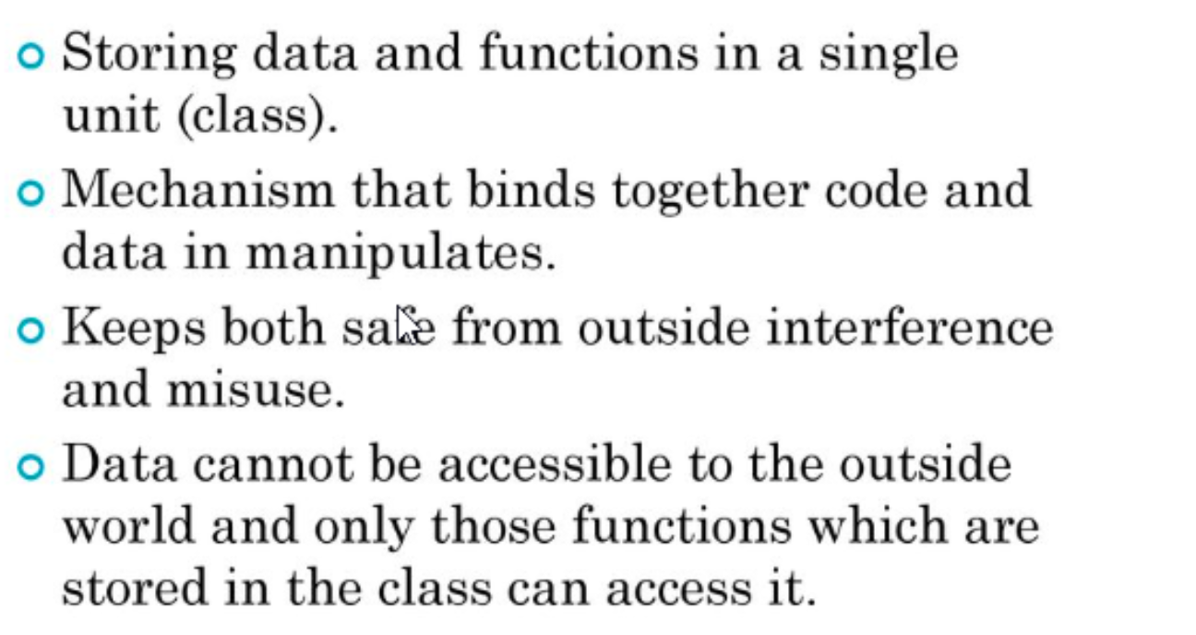
Encapsulation

Slide 9

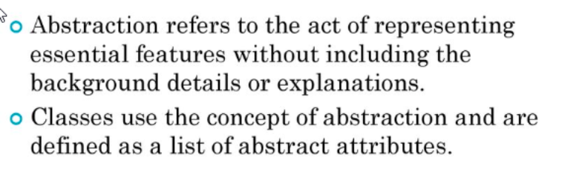
DATA Abstraction

Slide 10

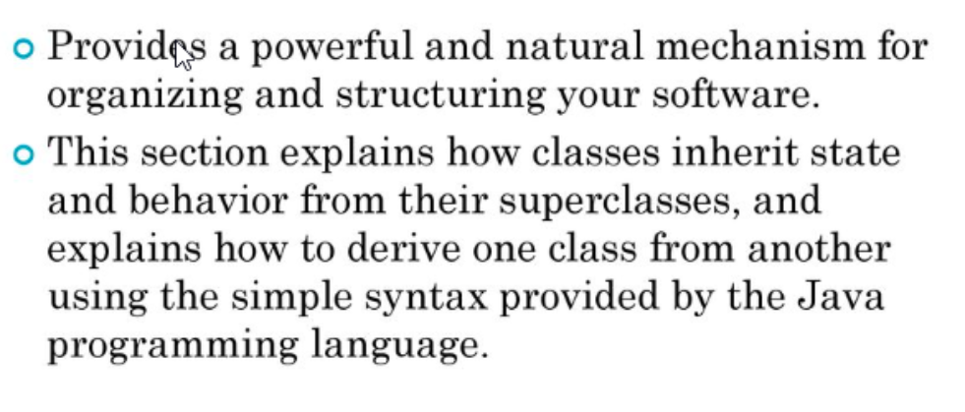
Inheritance

Slide 11

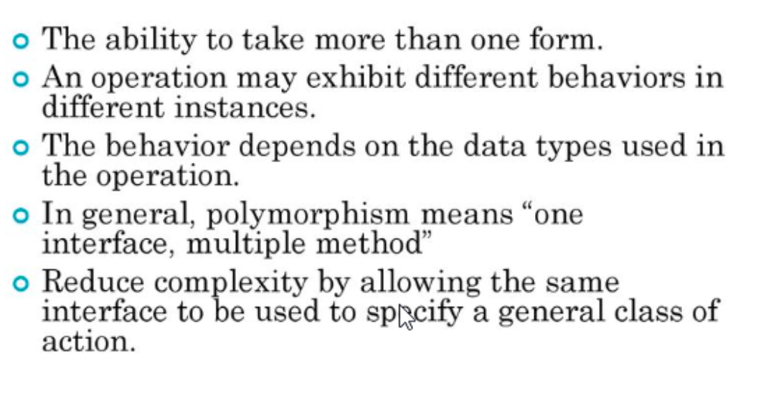
Polymorphism

Slide 12
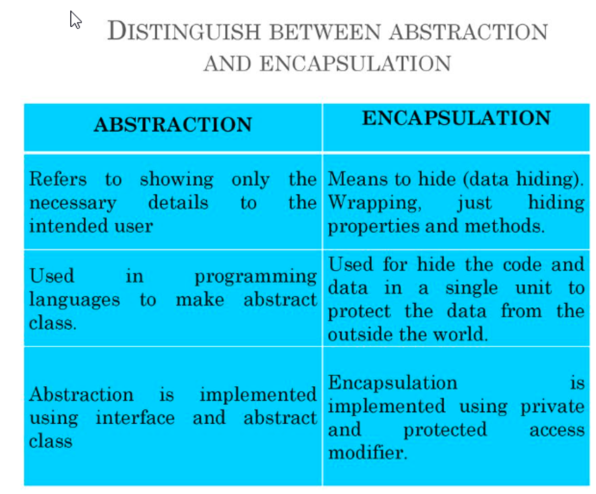

Slide 13
Encapsulation
Class Encapsulation
{
private int marks;
public int Marks
{
get { return marks; }
set { marks = value;}
}
}

Slide 14
Abstraction
abstract class Abstraction
public abstract void doAbstraction();
public class AbstractionImpl: Abstraction
public void doAbstraction()
//Implement it
}

Slide 15

Benefits of OOPs in Java
1
Advantages
2
Scalability and Flexibility
Uncover the benefits of using OOPs in Java, such as code reusability and maintainability.
Learn how OOPs enhances code scalability and flexibility in Java programming projects.

Slide 16

Common Mistakes and Challenges
Common Mistakes
Overcoming Challenges
Identify common mistakes to avoid when implementing OOPs in Java for robust and efficient code development.
Face the challenges that arise when working with OOPs concepts and discover tips and strategies to overcome them.

Slide 17
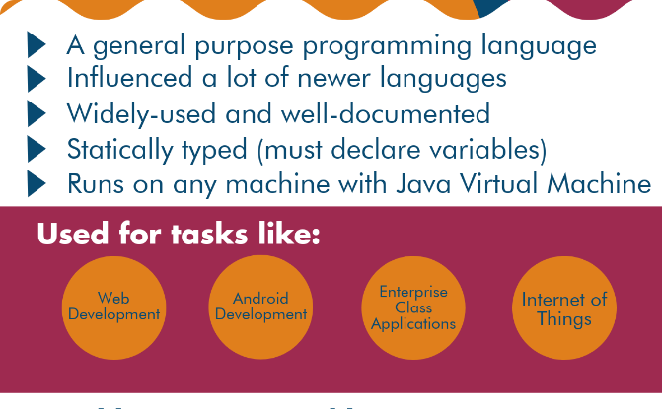

Conclusion
Recap of Important Points
Further Learning
Recall the significant points discussed during the presentation on OOPs in Java.
Encourage continued learning with additional resources to expand your knowledge of OOPs in Java.

